Slide 1


Slide 2
FSI Potpourri – Quiz
The boot is on the other foot
IIM Ahmedabad
12th of December, 2014
Faculty Student Interaction Cell

Slide 3
Rules and Credits
Infinite Pounce
  +10/-5
  Open for 10 seconds
Bounce - Direct / Pass
  +10/0
  Open for 5 seconds
General Round
  Half Clockwise, Half anti clockwise
Themed Quiz – Answer in your sheets
Connect – Answer in your sheets
Question to the team next in line to the answering team or the team that was asked if unanswered
Hints may be given if no one blocks
The quizmaster is dumb and rules with an iron fist
Credits to the following
Maggi, for inspiring everyone to Quiz
Wikipedia and Google, for obvious reasons
The time keeper, even though I will rule out indefinitely
The score keeper, no one overrules him
Happy Quizzing!!!

Slide 4
General Round
First 5 questions are clockwise, next 5 anti clockwise
10 seconds for pouncing, 5 seconds on the bounce
+10/-5 on pounce, +10/0 on the bounce
Next question rule as explained
Ambiguities to be resolved by me. You can’t submit a crib ☺.
Scores at the end of the round.

Slide 5
Q1 – Name it.
A framed copy of what, meant to be a tribute to a certain Leander Starr Jameson, is affixed to the wall before the study desk in the cabins of the officer cadets at the National Defence Academy at Pune?
A portion of it is also on the wall of the players’ entrance to the Centre Court at the All England Lawn Tennis and Croquet Club, where the Wimbledon Championships are held.

Slide 6


Slide 7
Answer
Rudyard Kipling’s “If”
Great if you knew who Leander Starr Jameson was

Slide 8
Q2 – Identify the person in the pic.
Identify this person, notable for many firsts in Indian Cinema. Most popular for a certain piece of work (another first), he also gave India its first motion picture made with international collaboration, the first English feature film, and the first indigenous colour film.
Picture on the next slide.
It’s grainy, if you wanted some hints.

Slide 9
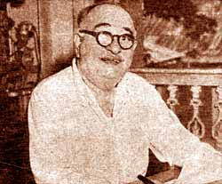

Slide 11
Answer
Ardeshir Irani
You earn my respect if you name the four movies, but no points ☺

Slide 12
Q3 – Identify X.
X was born in Mardin, Turkey, 1908. She/he emigrated to Canada to his uncle’s place who was a photographer. She/he himself became a famous photographer, popular for portraits.
In 2000, when International Who’s Who drafted a list of 100 most notable people of the century, 51 among them were photographed by X one time or other.

Slide 14
Answer
Yusuf Karsh

Slide 15
Q4 – Connect. Exhaustive list (debated)
Ashwathama
Bali, or Mahabali
Vyasa
Hanuman
Vibhishana
Kripacharya
Parashurama

Slide 17
Answer
7 Chiranjeevi, according to the Puranas, Ramayana and Mahabharata
"Ashwatthama Balir Vyaso Hanumanash cha Vibhishana Krupacharya cha Parashuramam Saptaita Chiranjeevanam" - 'Ashwathama, King Mahabali, Vyasa, Hanuman, Vibhishana, Kripacharya and Parashurama are the seven death-defying or imperishable personalities '.
Others too have been called Chiranjeevi, but this is the most accepted list according to the scriptures

Slide 18
Q5 – Identify X
X is also called the Lou Gehrig's disease, and sometimes, Charcot disease. The term, Motor Neuron Disease (MND) is sometimes used interchangeably with X.
Descriptions of the disease date back to at least 1824 by Charles Bell. In 1869, the connection between the symptoms and the underlying neurological problems were first described by Jean-Martin Charcot. It became well known in the United States when it affected famous baseball player Lou Gehrig.
There’s a more popular term. X.

Slide 20
Answer
Amyotrophic lateral sclerosis (ALS)

Slide 21
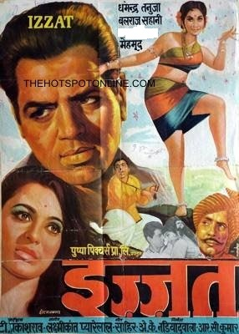
Q6 – Identify the lead dancer
Movie – “Izzat”
Sorry but VLC didn’t seem to work

Slide 22
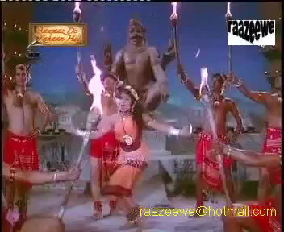

Slide 24
Answer
Jayalalitha

Slide 25
Q7 – Put Funda. Sitter.
Images on following slides.

Slide 26
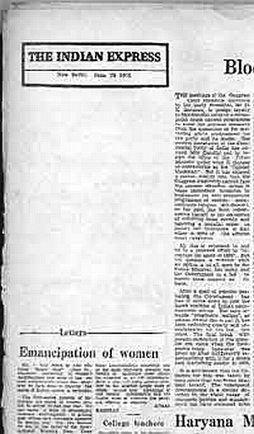

Slide 27
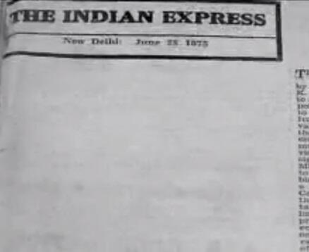

Slide 29
Answer
Indian Express protest against the imposition of Emergency

Slide 30
Q8 – The real life story of the film
Movie – Achanak
Director – Gulzar
Year – 1973 (not the incident)
Actors – Vinod Khanna, Leela Naidu, Om Shivpuri (not on cover)
Image on Next Slide

Slide 31
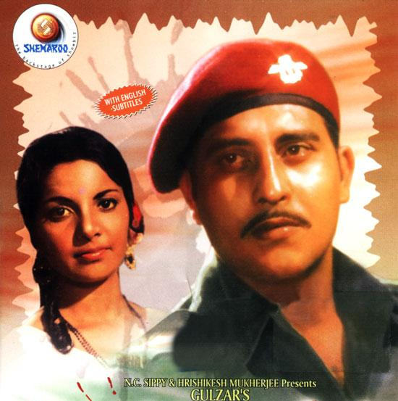

Slide 33
Answer
K M Nanavati vs State of Maharashtra

Slide 34
Q9 – ID both. No half points.
The two of them set up a film company that made movies based on short stories and novels, notably by E M Forster, Henry James and a certain person who will go unnamed.
The initial goal of the company was "to make English-language films in India aimed at the international market," but the company ended up making many films set in England and America.
Image on next slide.

Slide 35
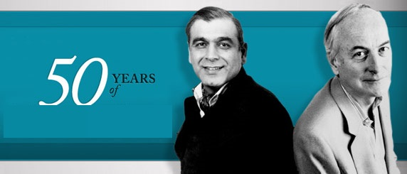

Slide 37
Answer
Merchant – Ivory
Ismail Merchant and James Ivory

Slide 38
Q10 – ID X. He wasn’t a smuggler, BTW.
X was a 17th-century Sufi, revered by both Muslims and Hindus, whose shrine is in Karnataka, India.
She/he is said to have introduced the coffee plant to India by smuggling seven beans from the port of Mocha, Yemen, which were then raised at the place that bears his name.
The story is now popularly recounted as “X and the seven seeds”

Slide 40
Answer
Baba Budan
Baba Budan Hills are named after him

Slide 41
Themed Quiz
The theme is IIM Ahmedabad
5 questions, all related to the theme somehow or the other
If you don’t get the relation, then remember there are no cribs ☺
Answer in your sheets with correct numbering. If you get the numbering wrong, you are doomed. Live with it.
+10/0 for every question
10 seconds on each question
Scores at the end of the round

Slide 42
Q11 – ID X.
X was an economist who served as India's first Railway Minister and subsequently as India's Finance Minister, taking office shortly after the presentation of India's first Budget, in 1948.
She/he presented two Budgets, but resigned following the 1950 Budget in protest at the increasing power of the Planning Commission and P. C. Mahalanobis.
She/he was the founding President of the Governing Body of NCAER. Her/his nephew, Verghese Kurien, was the father of India's White Revolution.
Her/his son is the connect with IIM Ahmedabad, no more hints.

Slide 43
Q12 – ID X.
X was a prominent businessman and industrialist popular with the Indian Freedom struggle for promoting the Swadeshi movement.
In 1948, X’s business group was named in the list of business houses indulging in black-marketing. India’s first Finance Minister, a close friend, had to resign because of a report which suggested that he had tried getting X’s name dropped.
X was eventually absolved.

Slide 44
Q13 – ID X.
X was born in 1948 in the village of Khimel, near Rani, Rajasthan, to a INC member father. X was from the 2nd batch of PGP programme, the youngest student at the age of 17.
X was awarded the National Merit Scholarship in both the years and took the diploma with the 5th rank in 1967.
X was a key figure in the first Detergent war, where he fought directly against VS.

Slide 45
Q14 – ID X.
X was educated at Cambridge, UK, and went on to do post graduate work in development communication at the MIT.
X is the founder of CEE, Ahmedabad, and is the chairman of the pharmaceutical company founded by his grandfather.
X’s sibling is an alumnus of IIMA, though it is not the only connection X shares with IIMA.
X is a very prominent environmentalist and social worker and is a Padma Shri awardee.

Slide 46
Q15 – ID X.
X was briefly the personal doctor to Mahatma Gandhi after returning to India from London and X joined the independence movement.
X was twice incarcerated (1938 and 1942) by the British government for X’s role in Gandhi's Satyagraha movement.
X served as the first "Dewan" of the erstwhile Baroda state, apart from other key posts in various ministries in free India.
X was also the Indian high commissioner to the United Kingdom from 1963 to 1966, a post he took up after a role for which he is most well known.

Slide 48
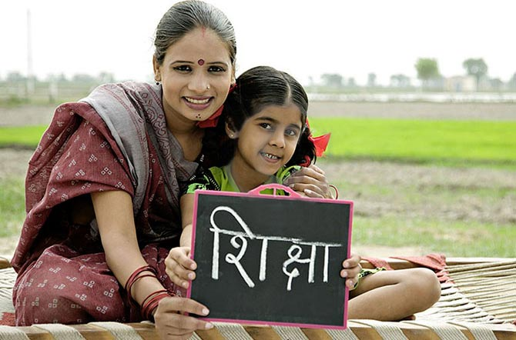
Answers
John Mathai
Kasturbhai Lalbhai
Ladbhi Bhandari
Kartikeya Sarabhai
Jivraj Mehta

Slide 49
Connect – Non Exhaustive List
5 questions, there is a specific connect that I need and I don’t need to remind you there are no cribs ☺
You can go for the connect right from question 1 and marks for the connect are indicated on each slide
Also, answer each question (ID the person in the picture) in your sheets with correct numbering. They will be evaluated at the end.
  +10/0 for every question
15 seconds on each question. I will throw hints along the way. NO BLOCKS
Scores at the end of the round.

Slide 50
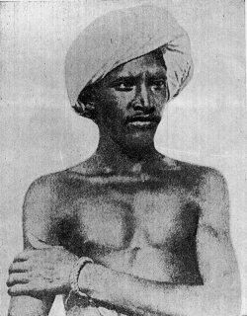
Q16 – +50/-20

Slide 51
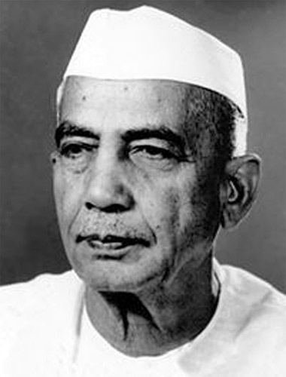
Q17 – +40/-15

Slide 52
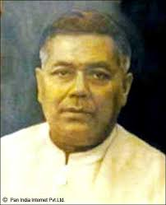
Q18 – +30/-10

Slide 53
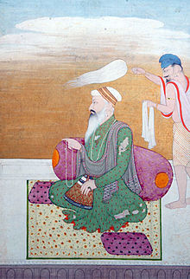
Q19 – +20/-5

Slide 54
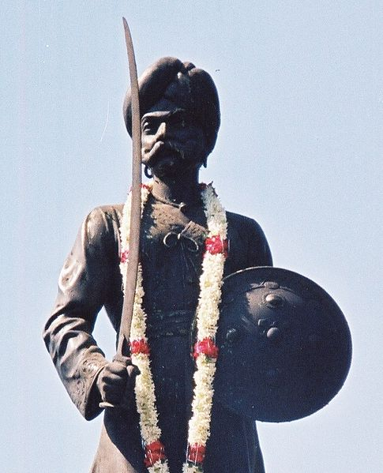
Q20 – +10/0

Slide 56
Answers – International Airports
Birsa Munda, Ranchi
Chaudhuri Charan Singh, Lucknow
Gopinath Bordoloi, Guwahati
Guru Ram Das Ji, Amritsar
Kempe Gowda I, Bangalore

Slide 57
END OF THE QUIZ
Congratulations to one and all. We will now proceed to the other rounds. Hope the quiz was fun.
You can actually drop me your cribs at p14tauseefw@iimahd.ernet.in I cannot change the outcome of the quiz, but it will help me learn new things.

Slide 59
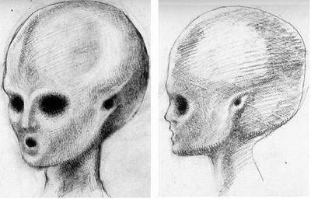
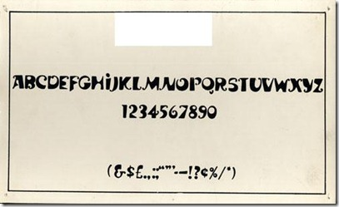
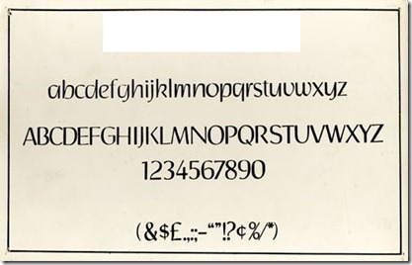
Bonus Tie Break Question/Audience Question
CONNECT?

Slide 60
Answer
Satyajit Ray

